Slide 1

RoboTour
A robot that improves your experience in museums
Notes:
Finn
This is RoboTour. RoboTour is a multi-purpose assistive robot tailored to museum visitors. Our mission is to provide a dynamic cultural experience for museum visitors by providing 2 key
For this final client demo, we will outline all our features in the whole systems and how we polished each feature and made them more stable
For each of these milestone, our members will also talk about what’s next steps.

Slide 2
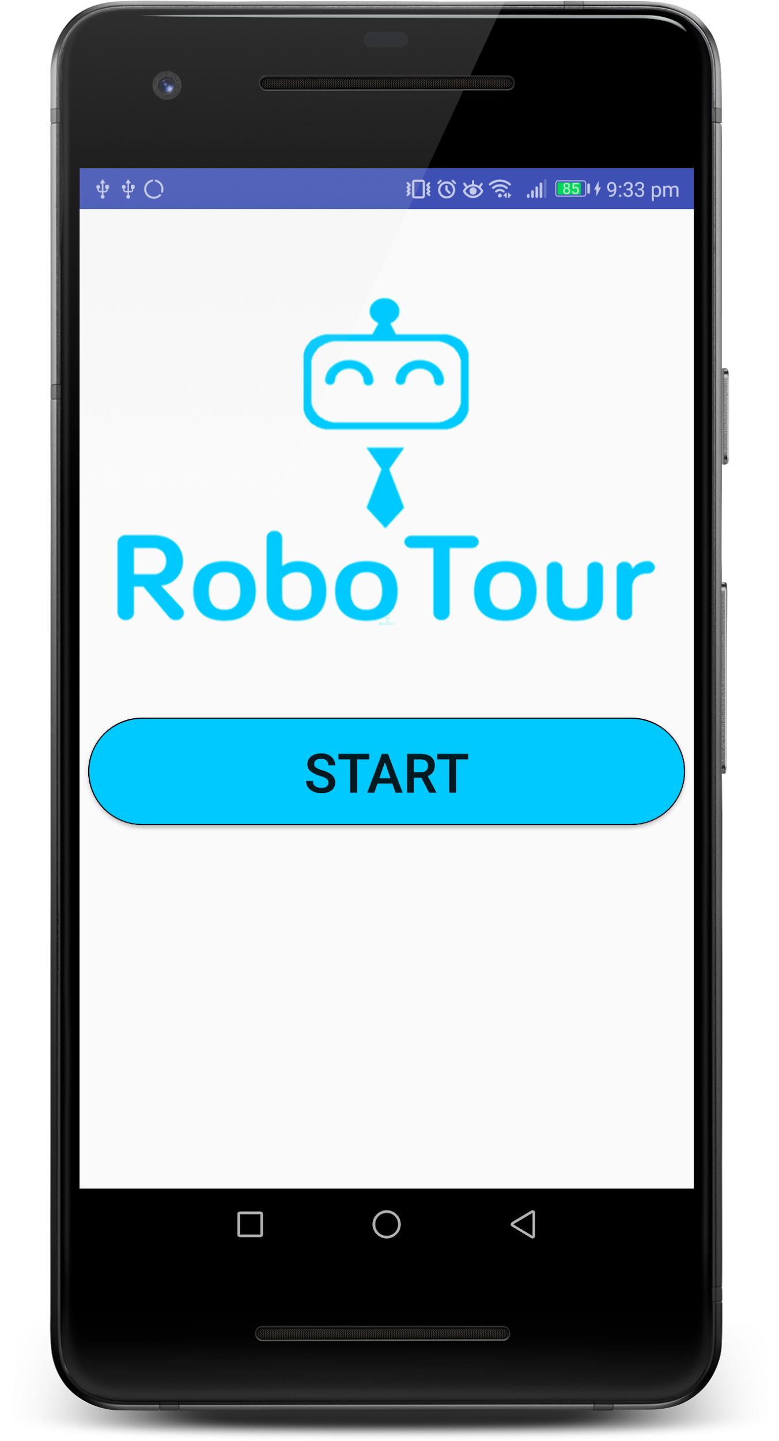
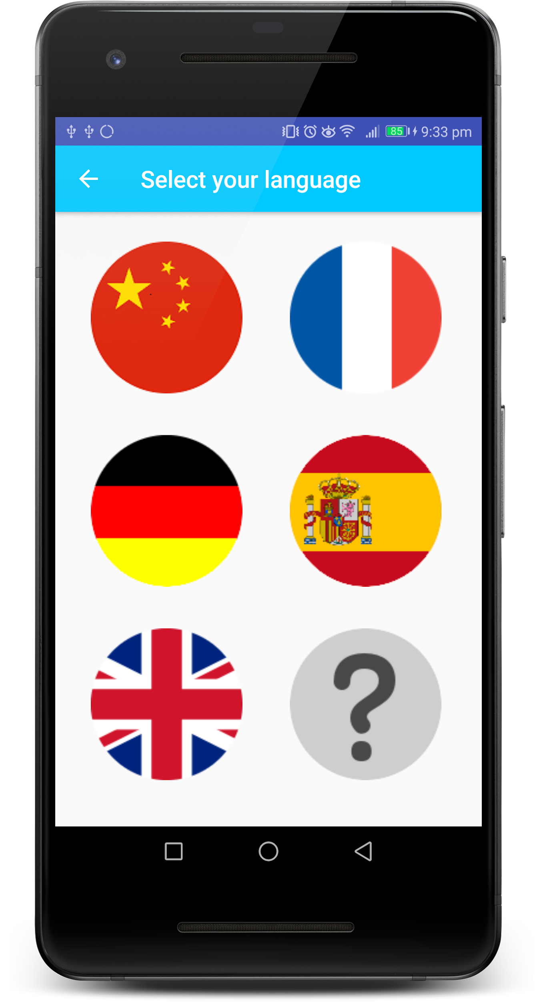
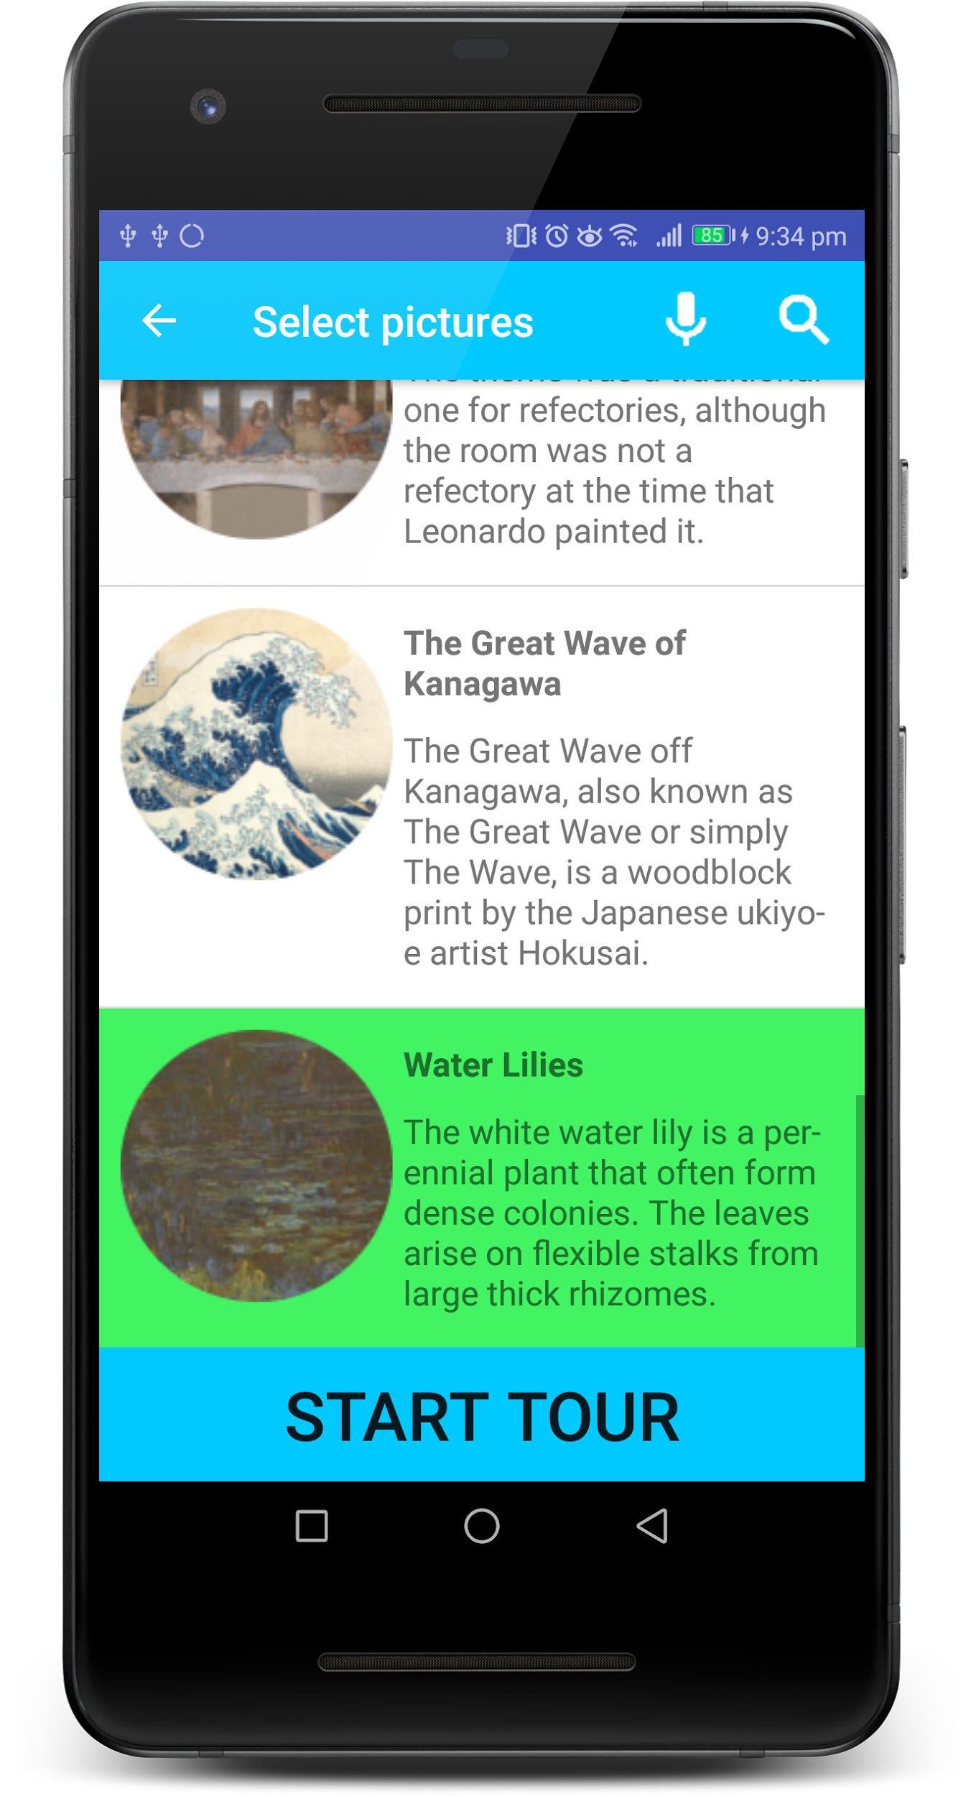
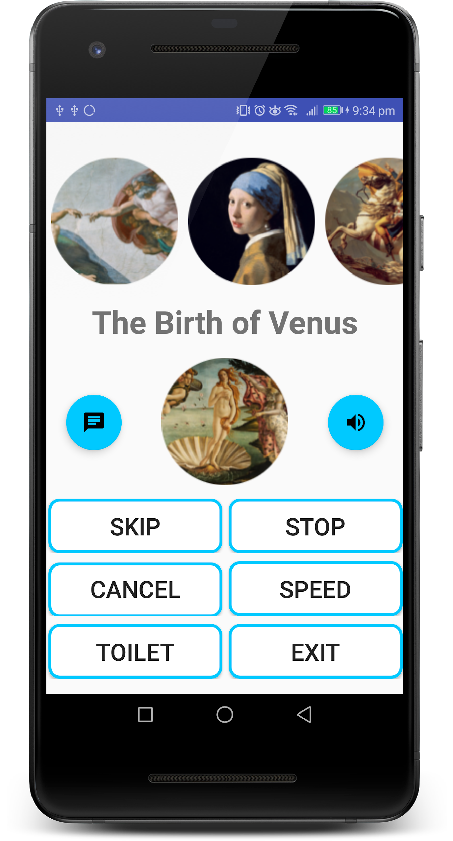
Android App
Fig 1: Homepage
Fig 2: Language Selection
Fig 3: Painting Selection
Fig 4: On Tour
Notes:
David
Intuitive UX
1-2-3
Search database
Previously Control Robot and description of current painting
You may have noticed it looks different from previous demos
Since the start of our journey the goal has been to create a simple app that any user can pick up and understand immediately.
So we created this simple app where the user simply selects their language, the paintings they want to go to and then the robot does the rest.
We also wanted the user to be able to easily search through our database of paintings so the user can search by typing or saying the name of the painting or artist or one of our recommendation commands.
Previously, when a user was on a tour they could control the robot, and see the description of the current painting.
But you may have noticed that the last activity looks different from what it did in previous demos.

Slide 3
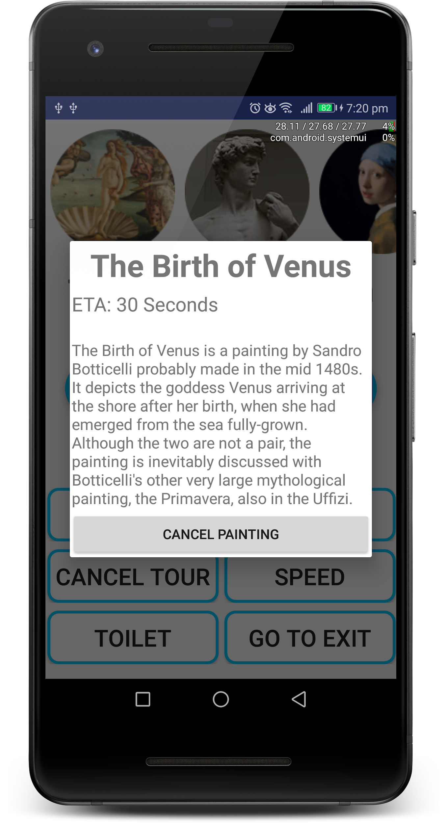
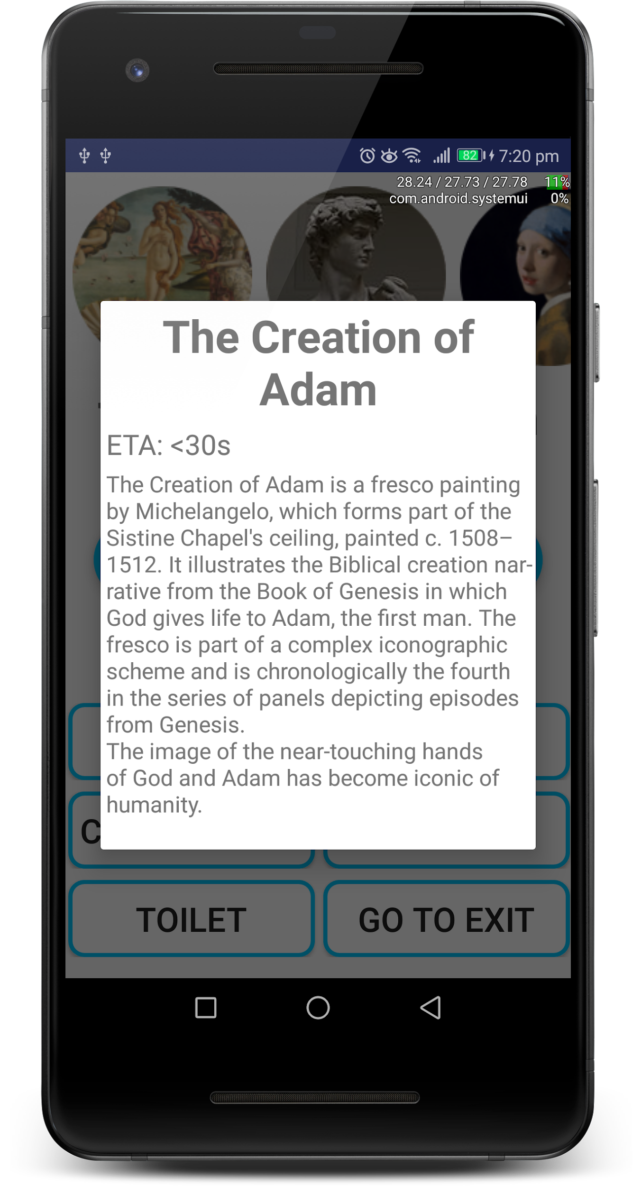
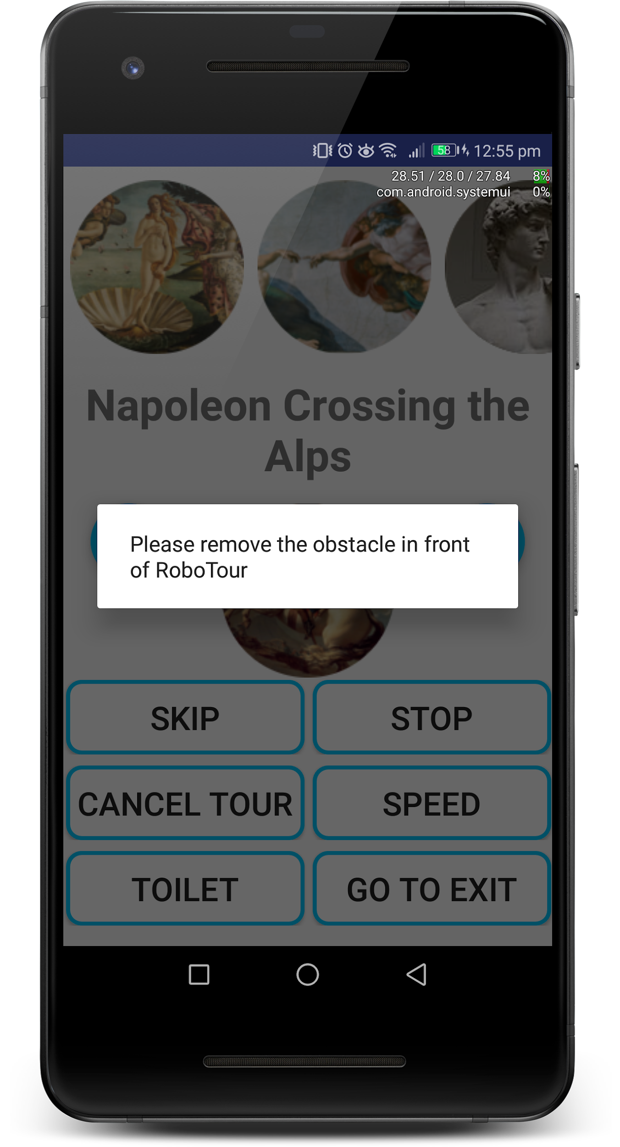
Final Client Demo: UI/UX Polish
Fig 5: On Tour
Fig 6: Description of
Upcoming Painting
Fig 7: Description of the
Current Painting
Fig 7: Alert When Obstacle
is Detected
Notes:
David
This is because we took your feedback onboard
You wanted order, eta, cancel and longer descriptions
So we did just this hsv that is ordered in the order you’re going to
When you click on 1 of the paintings…
Also added a notification on the app when there’s an obstacle
This is because we’ve taken the feedback from the last demo onboard and implemented them. You wanted the ability to know the order of the paintings you’re going to go to, an estimate of how long that will take, the ability to cancel any painting not just the current one and longer descriptions of the art pieces. So we’ve added all of these things you asked for in an ordered horizontal scroll view. When they click on one of the paintings in the scroll view they get it’s name, it’s description, it’s estimated time of arrival and the ability to cancel going to that painting, and lastly the text description has gotten longer.
And the last thing we added was a notification on the app when there’s an obstacle in the robots way that it can’t avoid

Slide 4
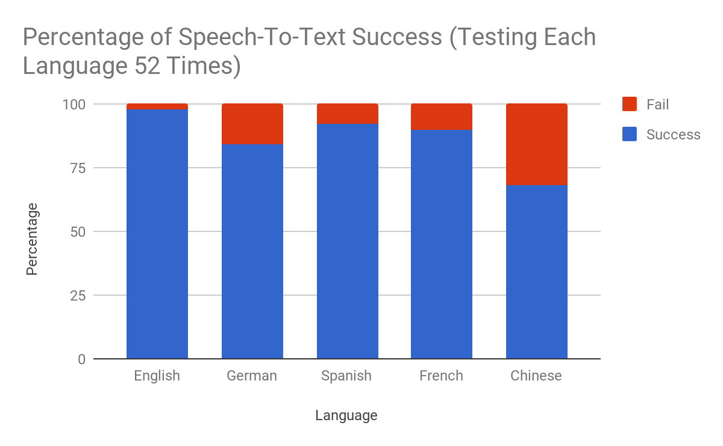
Speech-To-Text (Speech Searching) - Testing
Fig 9: Speech-To-Text Testing
Notes:
As far as quantitative testing goes we asked people from our group and other groups to try and break our app. When they found bugs we fixed them so we are confident that our app is robust
Here are the quantitative testing results with the speech-to-text searches.
We tested every possible command four times to see how well the speech-to-text works.
We found somewhat predictable results. English performs the best (only failing once). French and Spanish are very similar (failing 4 and 5 times). German failed 8 times, and chinese failed 16 times.
We found that usually if you enunciate the words more this error rate would decrease even further
The reason why chinese is the worst is because for the alphabetic languages we can easily pattern match but with the Chinese ones we had to translate to English first and then pattern match which means there is another step in which an error can occur and also because chinese is more difficult for the google api to understand.

Slide 5
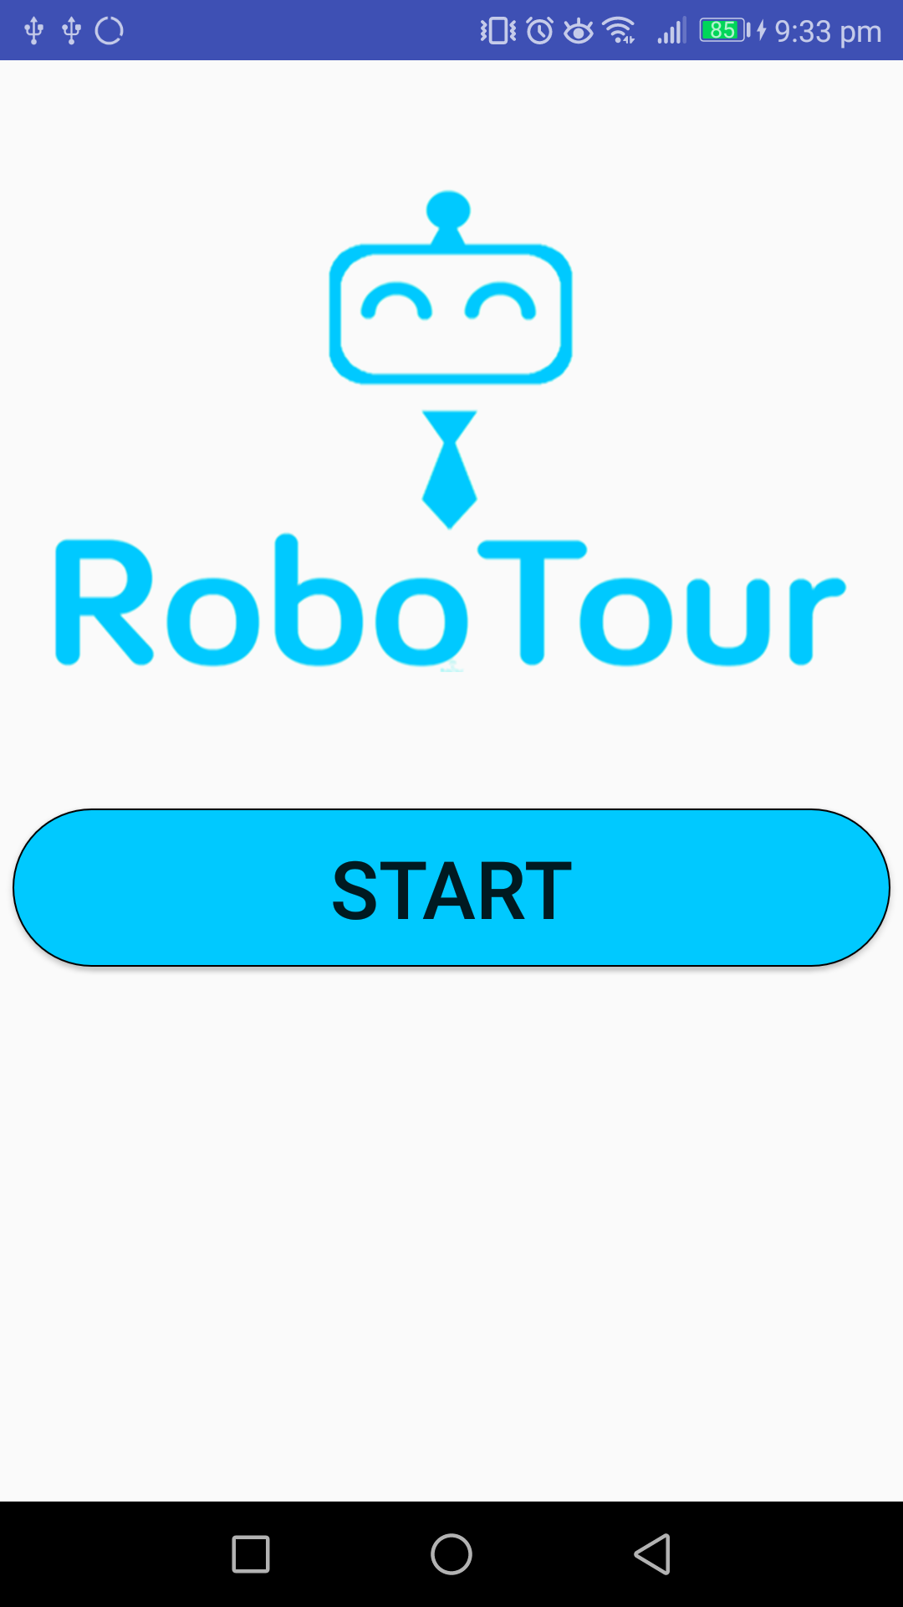
Bonus Features: Multi Phone Support
Fig 10: Multi Phone Support Example
Controller
Controller
Server
………...
Follower
Follower
Notes:
Mahbub
Use Case / Why?
When we think of a museum tour we think of a fairly large group of people (maybe ~10) being guided by a single tour guide. With previous versions of RoboTour only 1 or 2 people could follow a tour with the optimal RoboTour experience because only one smartphone could access the tour. Now with multi-phone support we allow up to 2 people to control a tour and as many people as makes sense to follow a tour. Now in a family of say 5 the parents can both independently select the paintings, and the children can follow the tour. If say a chinese couple then wants to use RoboTour while there isn’t one free, they could select their language and follow the tour that the parents specified in Chinese.
Because we don’t want an entire family to gather around a single, small smartphone we added Multi Phone Support.
How it works?
Explain the image in slides

Slide 6
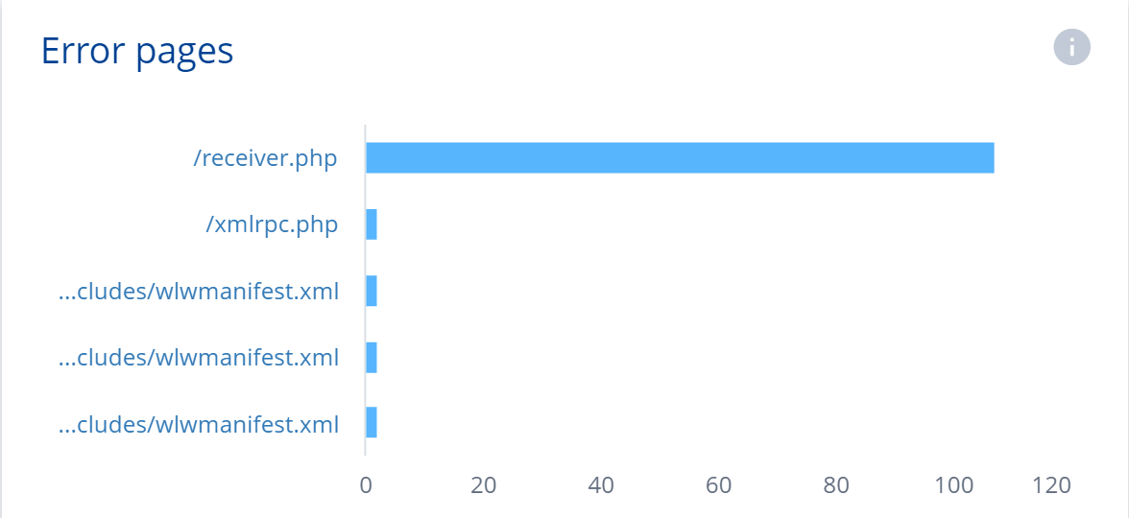
Server
Fig 11: Server Error pages

Slide 7
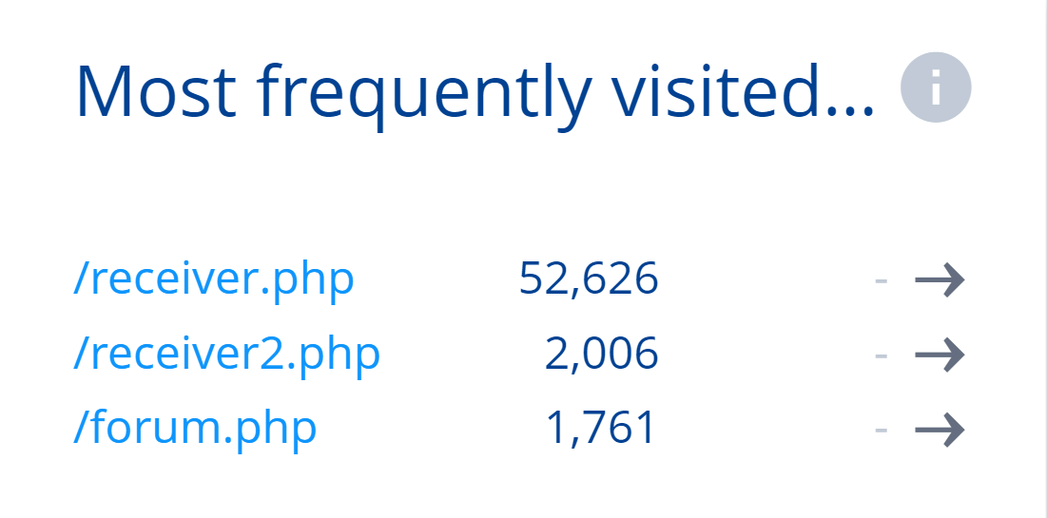
Server
Fig 12: Server Most Frequently Visited

Slide 8
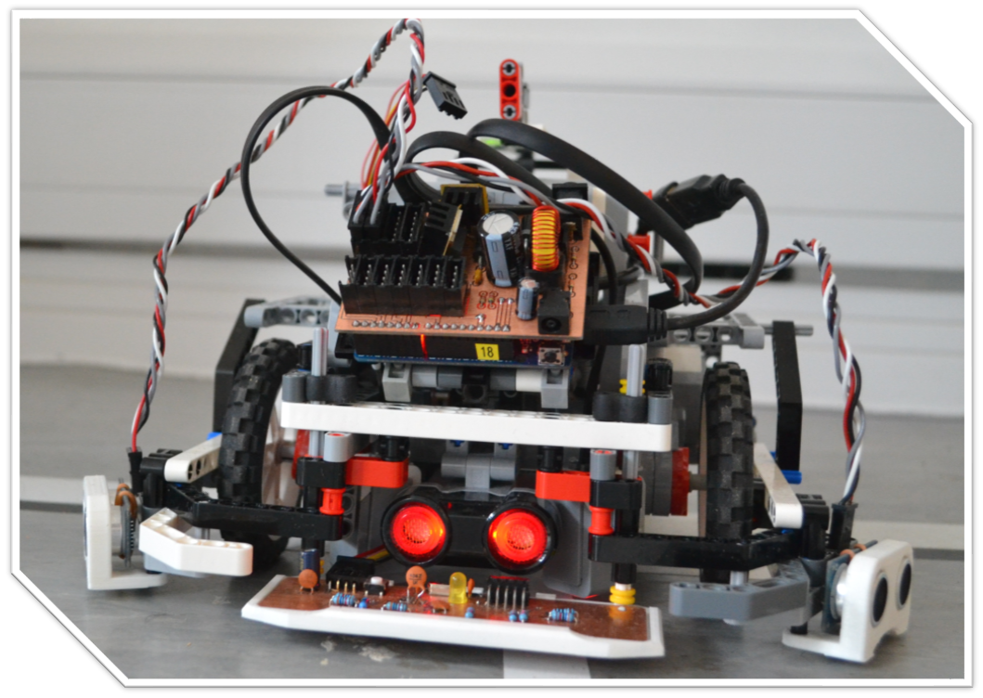
Physical structure
Fig 13: Robot

Slide 9
Sensor suite
Sensor | Primary Function
LEGO Ultrasonic | Obstacle detection
External Ultrasonics (x2 - via hub) | Obstacle avoidance and detection
LEGO Colour (x2) | Environment features identification
Custom Line sensor (via hub) | Line following and branch detection
Notes:
michal

Slide 10
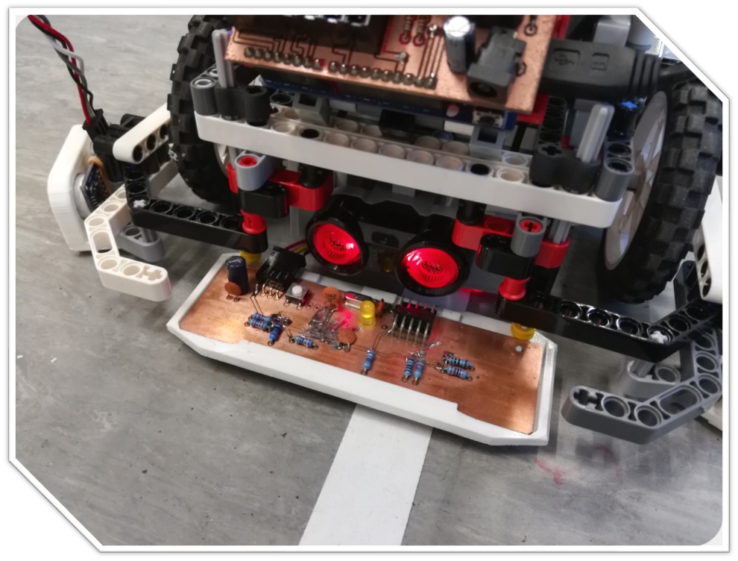
Final Client Demo: Line Following Polish
Fig 14: Custom Line Sensor
Notes:
Credit: Finn
michal

Slide 11
Line following and branch navigation
Following using custom sensor and PID controller
Constant input, account for disturbances
Overshoot (line-lost) compensation
Branch detection using moving window thresholding
Localisation using branch-counting
Branches used as decision points

Slide 12
Custom line sensor objectives
Sensor feature | Functional benefit
Higher tracking range | Tolerance for error and natural behaviour
Higher effective resolution | Smoother line-following
Higher polling rate | Faster robot speed
True side differentiation | Robust line-lost handling
Notes:
michal

Slide 13
Tracking range and effective resolution comparison
LEGO Sensor | Custom Sensor
~10mm range | ~100mm range (x10)
Notes:
michal

Slide 14
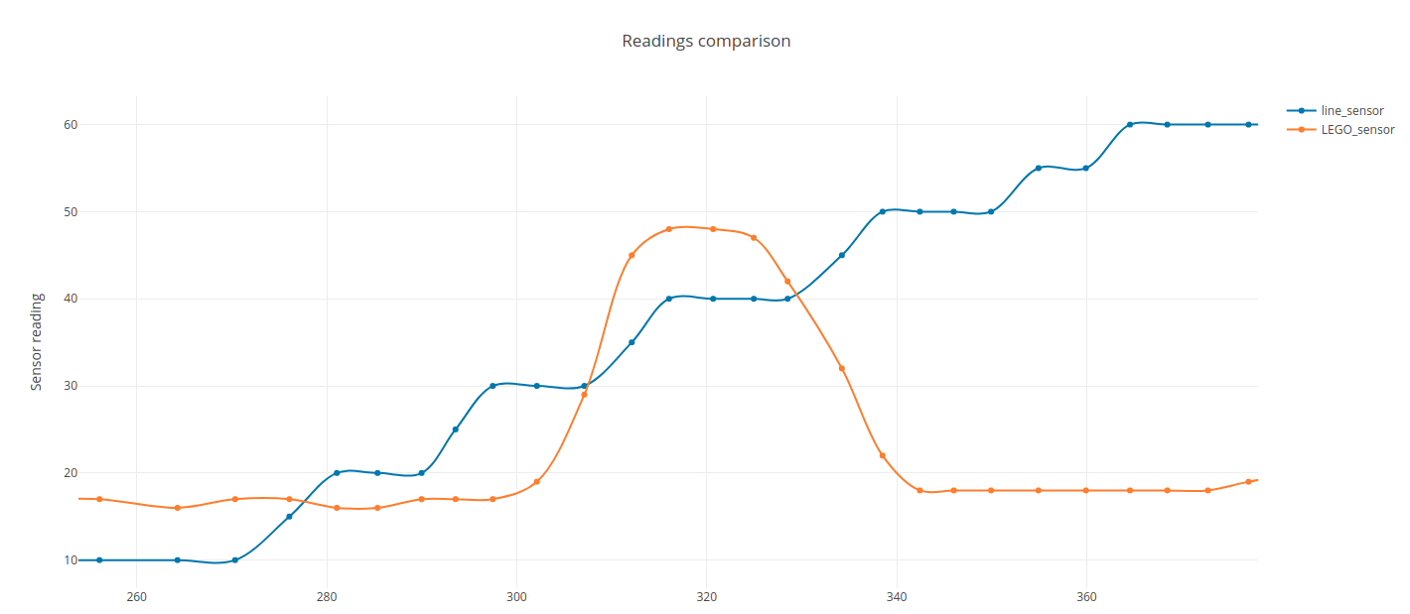
Tracking range and effective resolution comparison
Distance [mm]
Notes:
michal

Slide 15
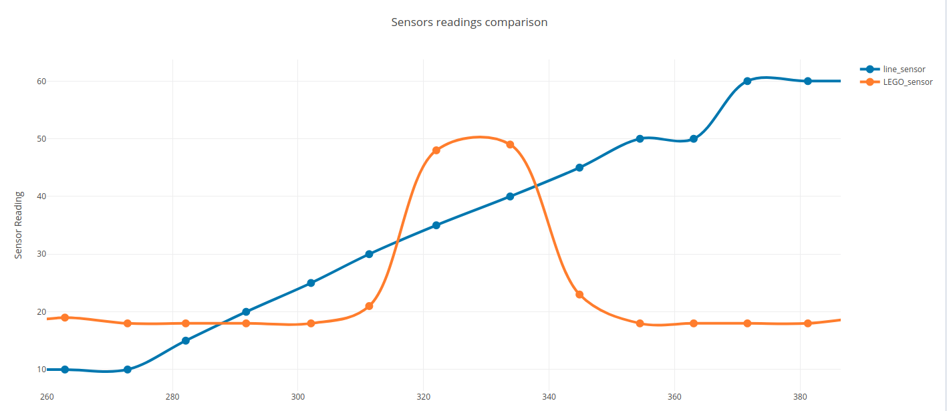
Tracking range and effective resolution comparison
Distance [mm]
Notes:
michal

Slide 16
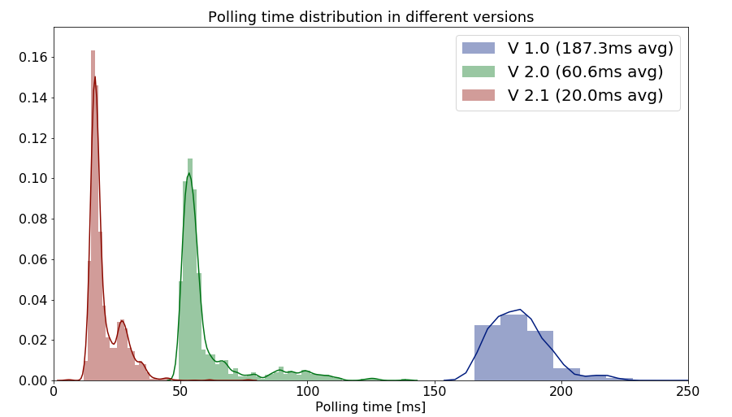
Polling time improvement

Slide 17
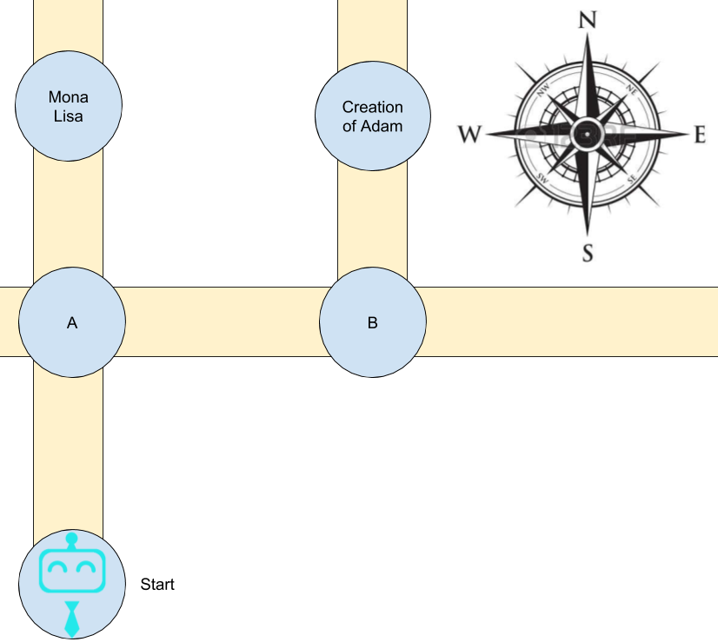
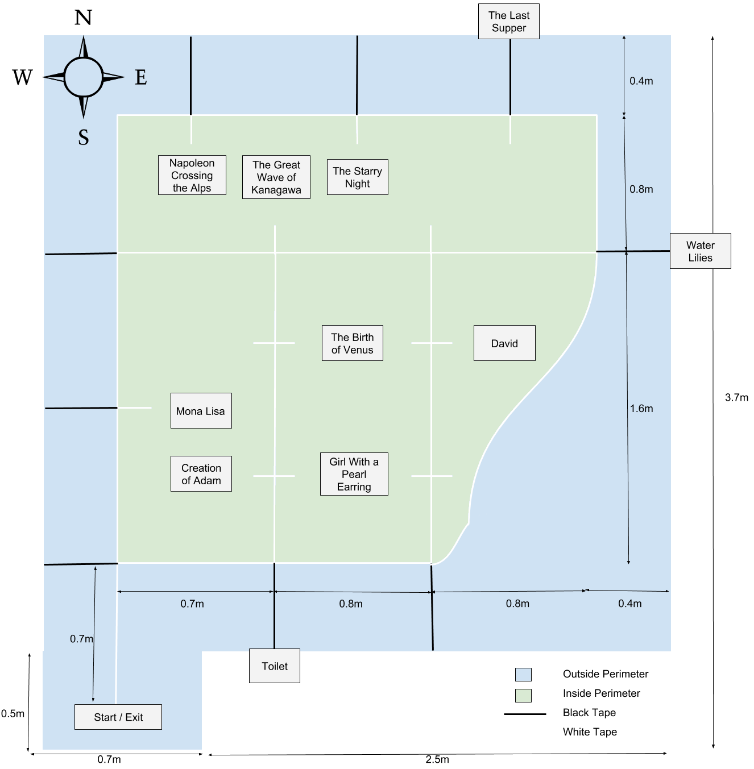
Navigation and Obstacle Avoidance
Fig 15: Navigation Example
Fig 16: Map
Notes:
Alice
The main idea for our robot to plan the route is that it go the closest painting, and after arriving that painting it go to the next closest painting. And we use Dijkstra algorithm to find the shortest path between current position and all the paintings, and compare the distance to decide which is the closest.
Our robot do obstacle avoidance as well, because it makes no sense that if there is enough space for robot to pass through but the robot just stupid stop and wait.
This is the map we are using now. We are using white tapes for line following and black tapes to indicated branches. We use the blacks because we don’t want to miss the branch when doing obstacle avoidance.
In last demo, what we did was adding many blacks and when it detected it turn back. But considering there will be tourists walking behind the robot, it is unreliable to make the robot go back. And because of the limitation of the room, it is definitely not enough place for the robot to do obstacle avoidance inside, so we change our algorithm - it will disable obstacle avoidance in the inner area (green) and it will stop and wait, just like human - if someone block your way you will ask them to go away. And in the outer area (blue), it will do obstacle avoidance as normal. And if it hit the black lines, that means it has reached a branch, it will either count for it and pass it, or turn and wait for it being moved away. Compare to the map we had in last demo, it require less tape but performing much better.
Navigation - Alice
Map? - talk about the setup? Tape? Green tape for losers (Require less tape but much better) (Don’t wanna miss branch when obstacle avoidance)
(Dijkstra? Yes) - Shortest path planning (when it occurs?? At the beginning and at each painting (at the start and whenever the user changes paintings selection or decides to go to exit/toilet))

Slide 18
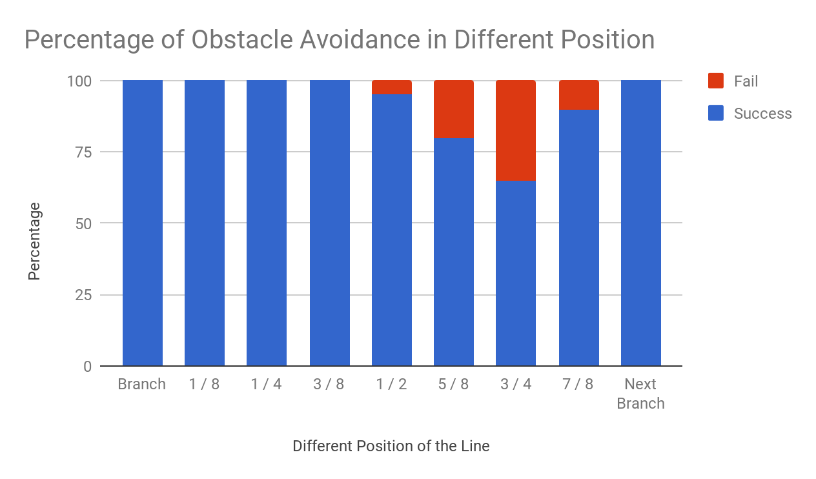
Obstacle Avoidance Testing
Fig 17: Obstacle Avoidance Testing
Notes:
Alice
But there are limitations with obstacle avoidance. Compare to the last demo, we improved it by checking the position from the branch - if it is too closed we will disable obstacle avoidance - otherwise it will count for the branch twice.
So as you can see on the graph, it success almost every times at the first half of the line. It fails quite a lot at the second half of the line because of the position of the colour sensor. The custom line sensor may hit the branch but the colour sensor did hit the blacks, so it will miss that branch or enter the wrong line.
So it performed better if the obstacle is closer to the next branch - because the colour sensor can see the black line. But there still be problem because of the limitation of the ultrasonic sensor.
When it think it has not enough place to go through, it will stop and wait, it needs user to remove the obstacle
Hit black line turn but cannot pass because the sensor cannot see
Cannot go backward because people following
Limitations of tape colour - if it hits the outer black line it will get lost
(If not cover the greens) Limitations of other group - green is sometimes detected as black

Slide 19
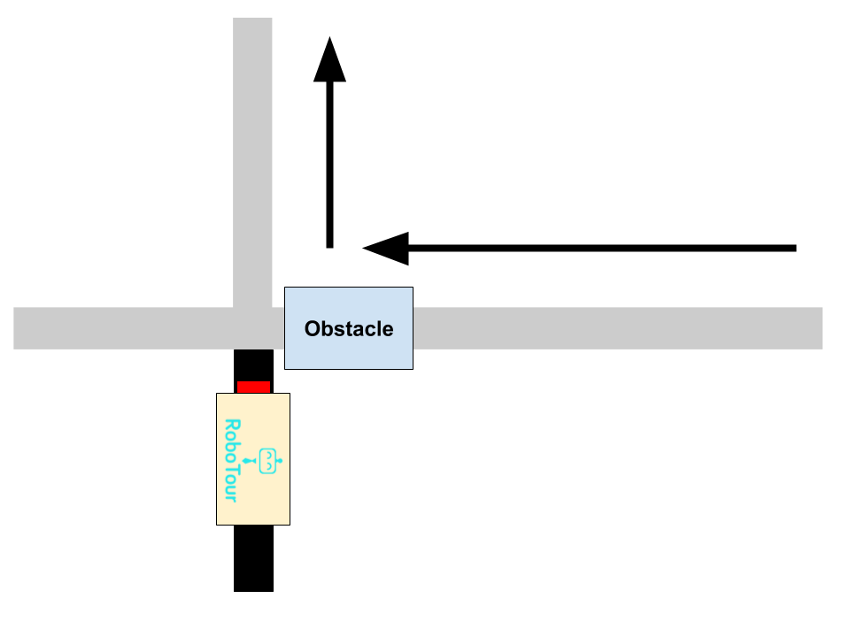
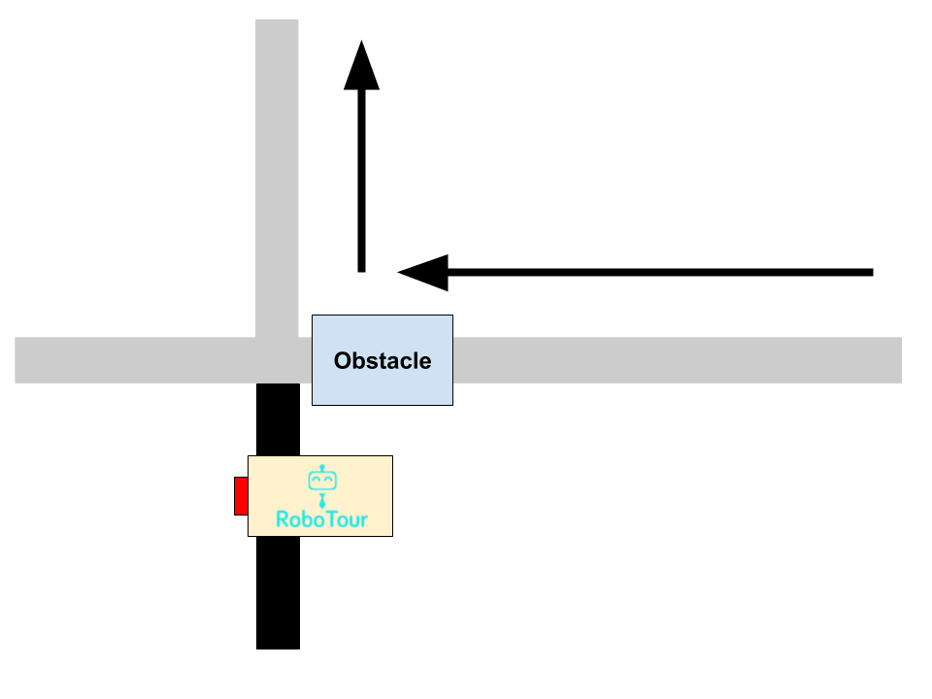
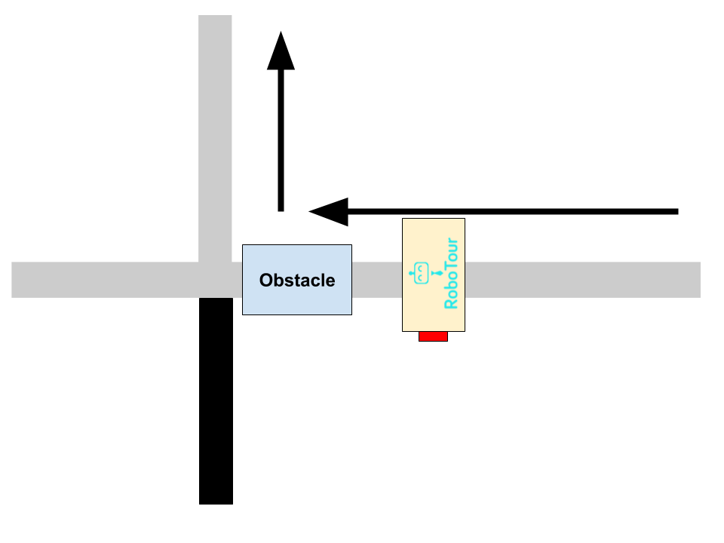
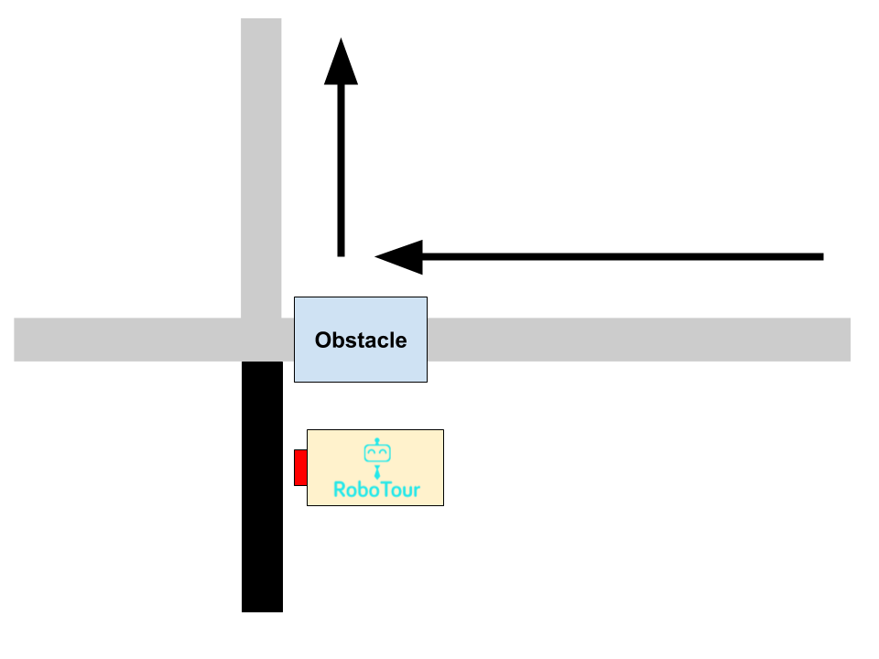
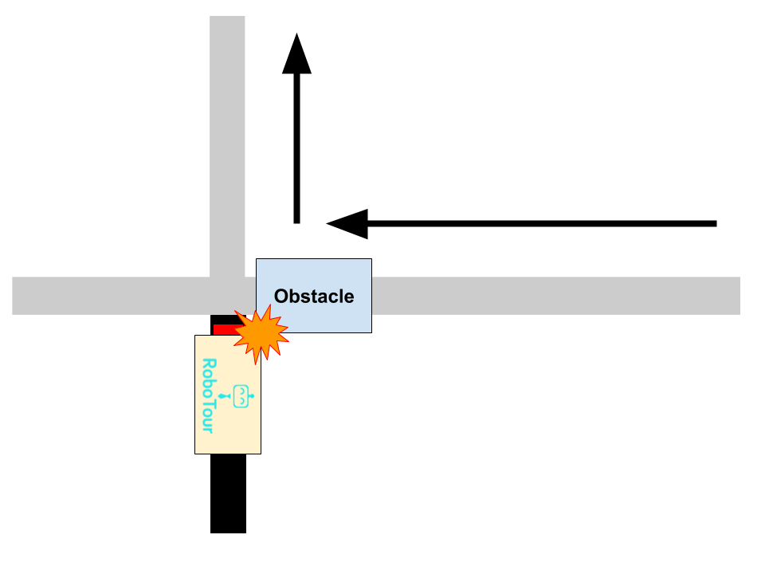
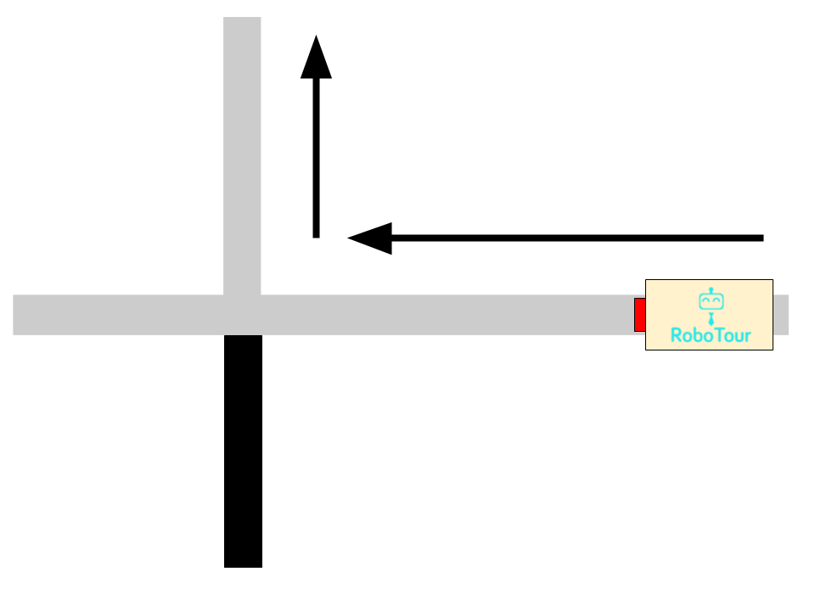
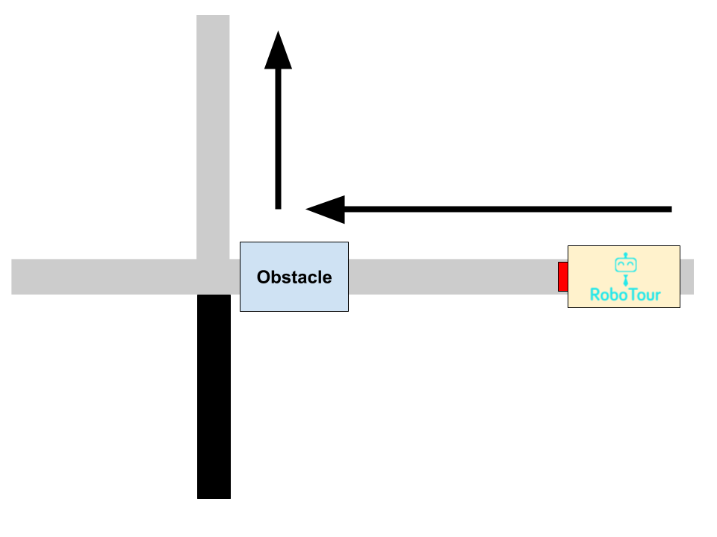
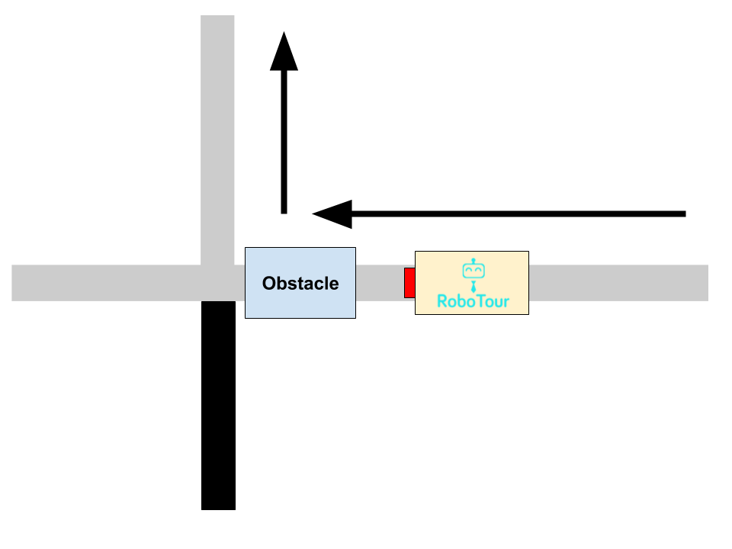
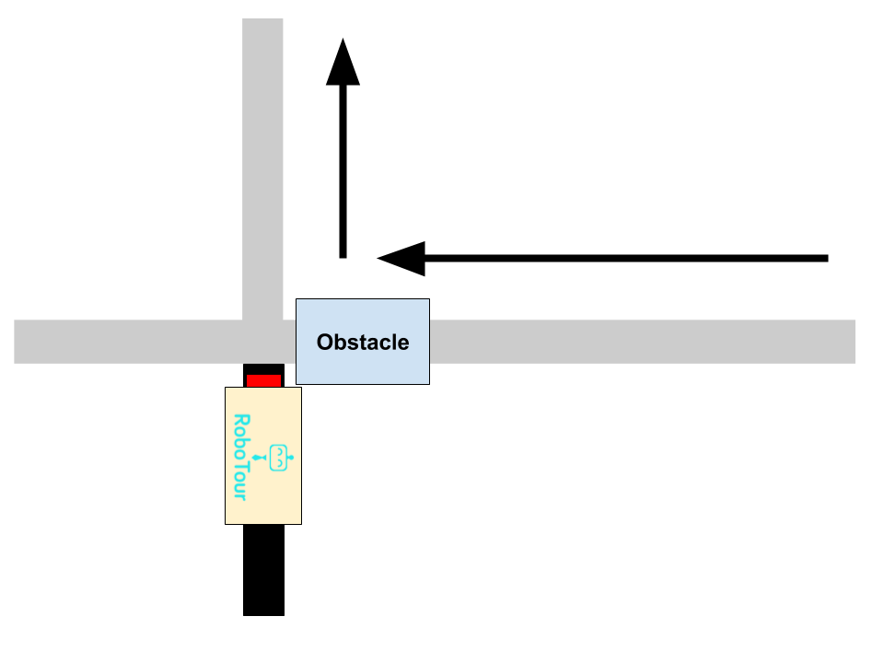
Obstacle Avoidance Limitation Example
Notes:
Alice
Next Finn Resource & Buget
Obstacle avoidance - mention why (Why??????? (W H Y??????????(Only have one path and it there is enough place it should go around instead of stpid waiting))) - Alice
Algorithm (Inside - stop, outside - go around(find black - count or turn and follow black)) - if too closed then stop
Limitations
When it think it has not enough place to go through, it will stop and wait, it needs user to remove the obstacle
Hit black line turn but cannot pass because the sensor cannot see
Cannot go backward because people following
Limitations of tape colour - if it hits the outer black line it will get lost
(If not cover the greens) Limitations of other group - green is sometimes detected as black
Last demo we found that the obstacle avoidance is not quite working, because it always hit the edge cases. And we noticed that it will never have enough place for the robot doing obstacle avoidance inside, because of the limitation of the room, so we disable obstacle avoidance inside the green area, where it will just stop and wait for the obstacle been removed. As for the outer area, we add single black line to indicate that there should be a branch, so if the robot hit the black line, it will know it has skip a branch. Moveover, we add a position detected. When the robot detected the obstacle, and if the position is too closed to the branch, it will disable the obstacle as well. This ensure that the robot will not count the branch twice.
Next Michal

Slide 20
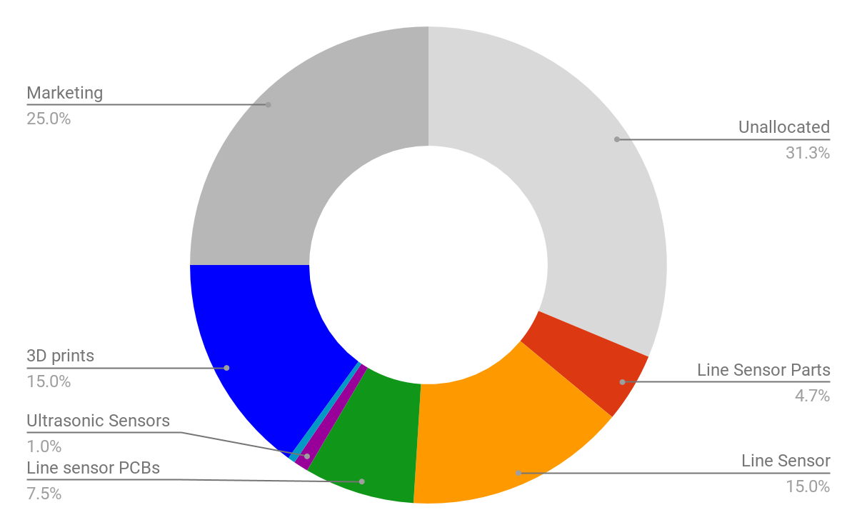
Resources & Budget
Time Spent: 175 Remain: 25 (hrs/member)
Guest lectures: 6 (of 6)
Demonstrations 4 (of 4)
Group meetings: 15 (of 25)
Planning and Admin 25 (of 40)
Debugging & Testing: 30 (of 30)
Code Reviews: 10 (of 10)
Robot construction: 10 (of 10)
Code development 75 (of 75)
Fig 18: Budget pie chart (£200)
Notes:
Mahbub
Main:

Slide 21
Summary and reflections
Project successful - milestones met, proof-of-concept functionality achieved
Committed and hardworking team contributing their individual skills and experience
Idea not fully explored - multiple improvements and enhancements possible
Inner-team workings improved as the project progressed
Should have started off with multi phone support from the start

Slide 22
Live Demonstration
Notes:
Mahbub
Credit: Finn

Slide 23
Thank You
We would like to welcome any questions or suggestions that you may have.
Notes:
We would all like to thank you for listening to our demonstration. We would like to invite you to have a look at our current system and would welcome any questions or suggestions you may have.

